Slide 1
PERCEPTION AND CRITICAL THINKING.

Slide 2
Introduction.
Perception refers to the sensory experience of the world.
Organizing, identification, and interpretation of senses to manipulate the environment.
Perception and logic are used to make decisions.
Perception is dependent on the understanding of various stimuli.
Notes:
Perception refers to the sensory experience of the world. Human beings use the perception to identify, organize, and interpret different stimuli in the environment. Perception and logic are the most relied upon when one is making a decision that affected their lives. Perception depends on five senses to understand the different conditions of the environment. The combination of the responses from the five senses is important during perception. Perception is the most important factor that determines creativity thinking. The response to different stimuli is made creative through perception.

Slide 3
Impact of the five senses on perception.
Signals are sent to the brain from the five senses.
Every sense affects how one perceives the world or environment.
The senses enable one to read and communicate about the places we are in.
Each of the five senses keeps us from any harm by provoking a stimulus-response (Nejeschleba, 2017).
Notes:
The five senses touch, see, smell, taste, and hear are important during perception. The senses collect signals from the environment and send them to the brain to process and interpret the correct response to be initiated. The senses are the determinants of perception because the brain perceives what is communicated from the five senses. The senses protect individuals from the environment's harmful conditions by communicating to the brain from the appropriate responses to make.

Slide 4

Barriers to effective perception.
Having expectations (Runco & Pritzker, 2020).
Stereotypes.
Selective perception.
Disabilities.
Notes:
Internal or external factors may limit accurate perception in the brain. They lead to inaccuracies in perception and may put the individual in danger. The expectations create predetermined results or perception and may, therefore, promote biasness. Stereotyping makes individuals already have an image of what kind of response is expected. Selective perception involves incomplete communication of signals from the five senses to the brain. Disabilities in either of the five senses expose an individual to uneffective perception because of the sending of wrong or no signals to the brain.

Slide 5
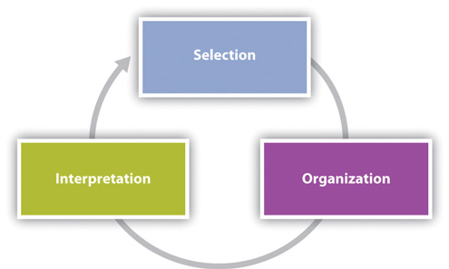
Role of perception in critical thinking.
It translates the sensory stimulus to relevant information.
It coordinates and interprets the signals from the senses (Kirmizi et al, 2015).
The efficiency of perception determines critical thinking.
It affects how one presents their ideas regarding any stimuli.
Notes:
Perception is very important for critical thinking because it influences how individuals respond to the various needs in the environment. Perception translates the sensory stimuli into information that can be used to make an informed decision from the environment. Perception is about coordinating and interpreting signals sent from the five senses into various responses. Critical thinking can be determined by how unique and through the perception of various events. Perception is put into action by presenting the various ideas promoted by the perception.

Slide 6
Conclusion.
Perception involves the coordination and interpretation of sensory stimuli.
Barriers to effective perception may lead to a wrong response to the stimuli.
Critical thinking can be promoted through perception.
Individuals should avoid barriers to effective perception.
Notes:
. Perception determines how one expresses ideas and feelings. It involves coordinating various sensory information towards a specific response. There are barriers to an effective perception that may result in wrong responses to various stimuli. Critical thinking can be promoted depending on how one perceives a certain situation by promoting logic before responding to any stimuli. Barriers to effective perception should be avoided by developing an open mind that depends on the senses purely to decide.

Slide 7
References.
Kirmizi, F. S., Saygi, C., & Yurdakal, I. H. (2015). Determine the relationship between the disposition of critical thinking and the perception about problem solving skills. Procedia-Social and Behavioral Sciences, 191, 657-661.
Nejeschleba, T. (2017). The Role of Senses and Sense Perception in Valeriano Magni’s Philosophy. Filosofický časopis, (2), 149.
Runco, M. A., & Pritzker, S. R. (Eds.). (2020). Encyclopedia of creativity. Academic press.

